Slide 1





India SDGs Dashboard
User Interface Guide

Slide 2
Objectives
To provide a national SDG dashboard integrating existing data of the all stakeholders
To create SDG indicators based database guided and owned by MOSPI and other stakeholders
To tract, monitor and report on the National SDGs Indicator framework
To develop a data portal to host the SDG dashboard and provide admin panel to manage the data centrally

Slide 3
The Sustainable Development Goals (SDGs)
Adopted by all United Nations Member States in 2015 at the 70th session of United Nations General Assembly (UNGM)
Call to to action to end poverty, protect the planet and ensure that all people enjoy peace and prosperity by 2030.
The 17 SDGs and associated 169 targets with 469 indicators
India adopted a Global Indicator Framework, consisting of 232 unique Indicators

Slide 4
The Sustainable Development Goals (SDGs)
The Ministry of Statistics and Programme Implementation (MoSPI) developed National Indicator Framework (NIF)
National Institution for Transforming India (NITI Aayog) has the overall responsibility of SDGs implementation and align government schemes/ programs to SDGs
The National Indicator Framework (NIF) currently comprises 306 indicators for different targets and goals

Slide 5
The System
one stop shop for all the SDGs requirements in India
a web based application to store, manage and disseminate SDGs indicators based data
comprises of two applications
SDGs Dashboard
Data Manager

Slide 6
Dashboard
http://itmcloud.org/india-sdg/frontend/

Slide 7

Home Page
Click here on explore SDGs

Slide 8
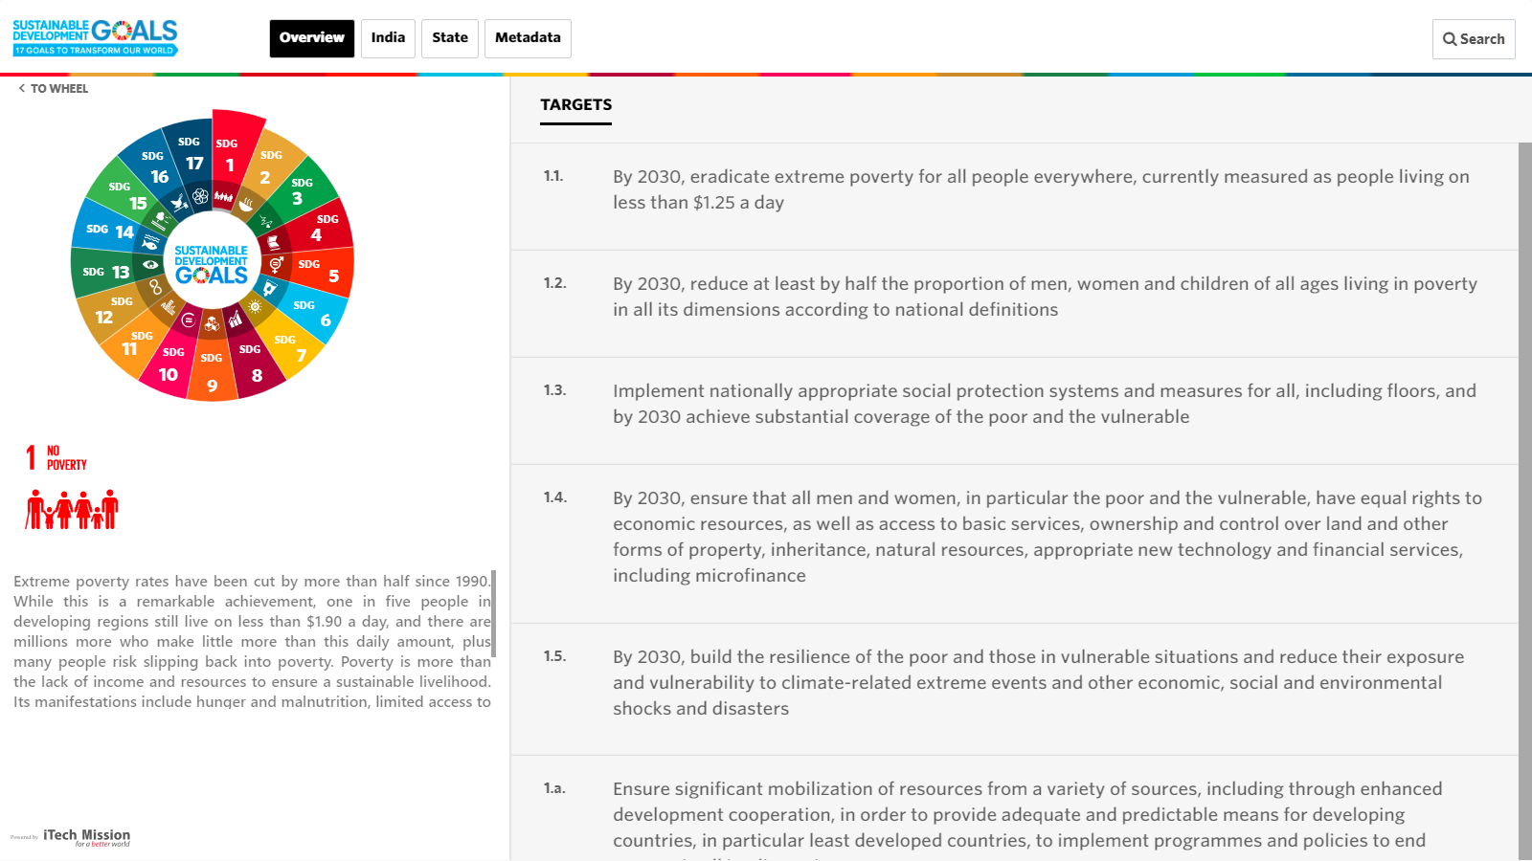
SDGs Dashboard
Click here on India to view visualizations goal wise
Search indicators
Click here to change Goals

Slide 9
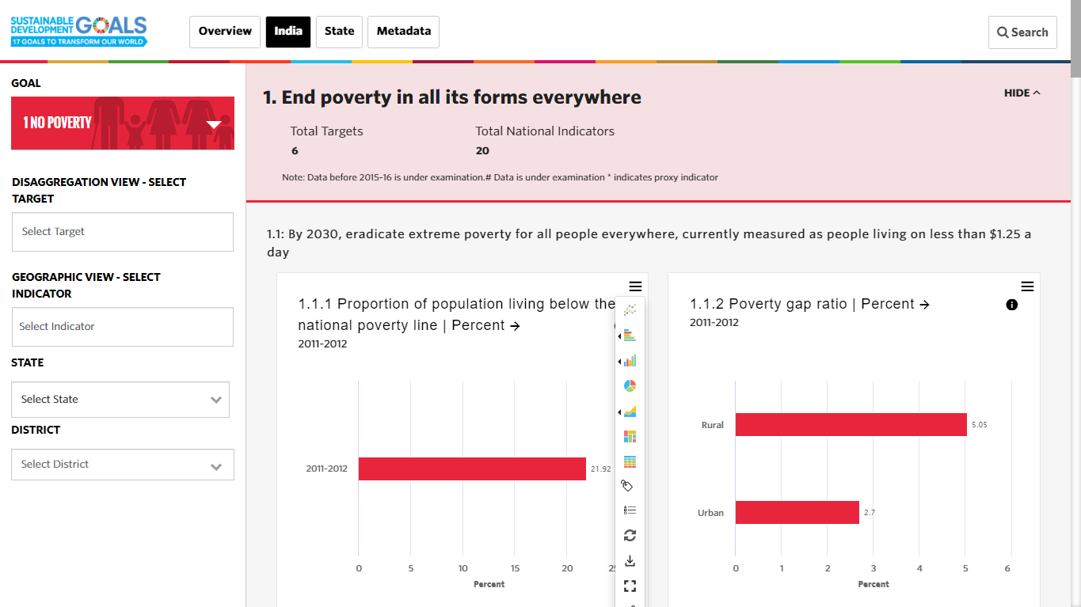
Dashboard Visualization
Hide/show the details
Click here to select goals
Chart types
Data Table
Label
Legend
Swap
Download
Full screen
Share

Slide 10
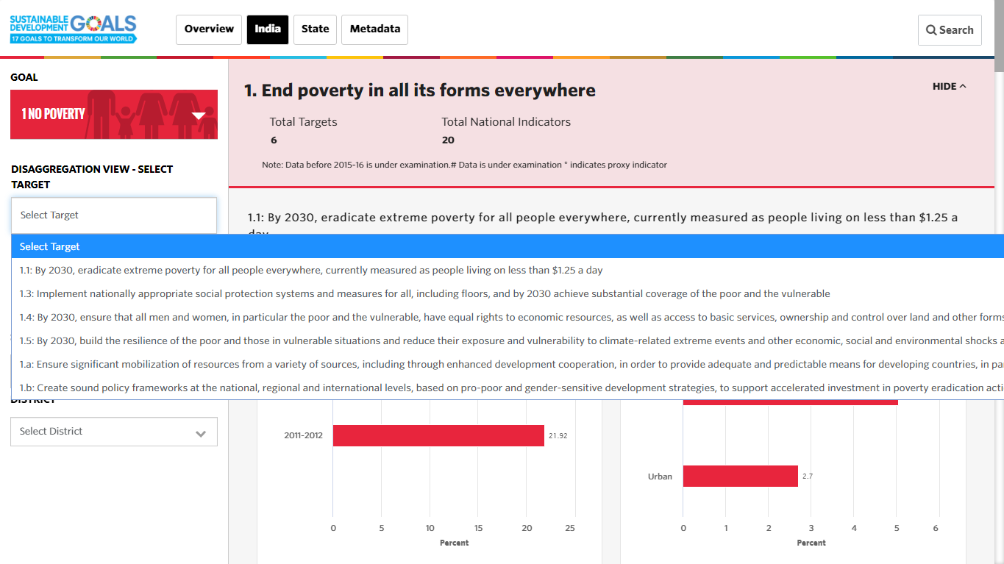
Disaggregation View
Select target for disaggregation view

Slide 11
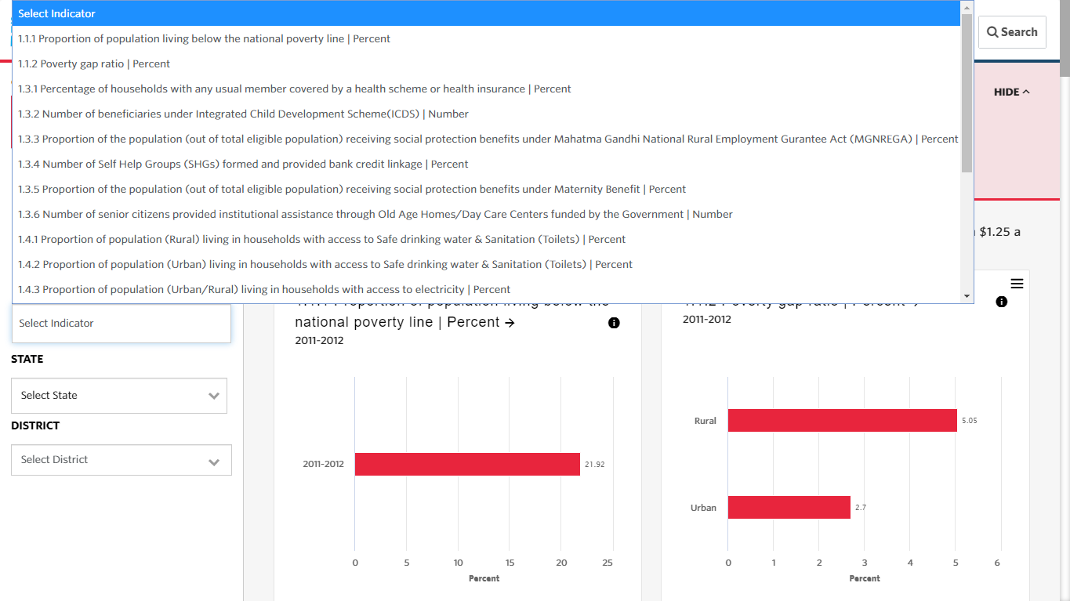
Geographic View
Select indicator for geographic view

Slide 12
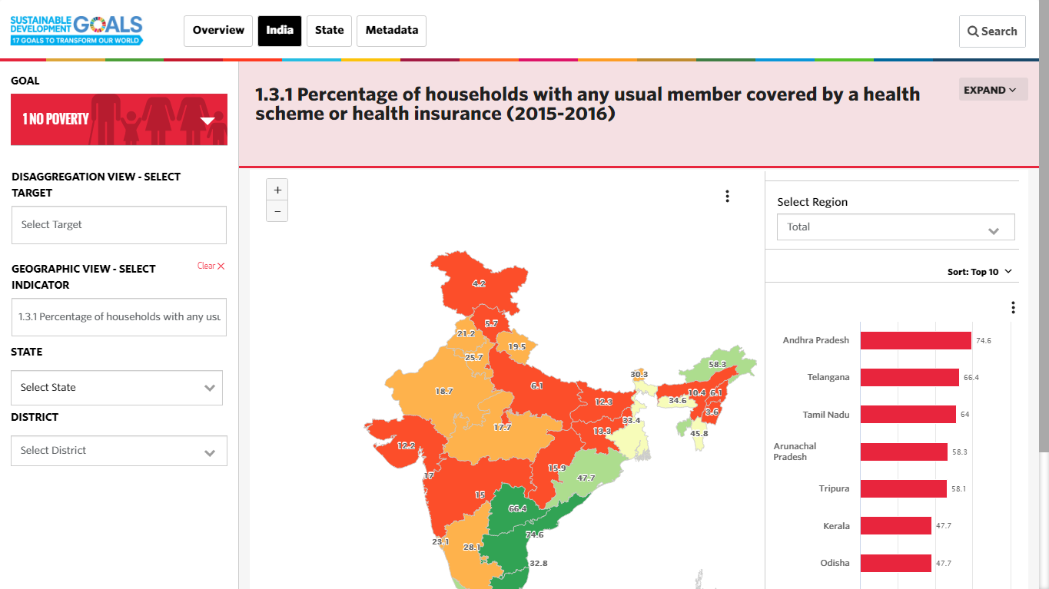
Geographic View
Enable or disable states and Districts
Zoom in/out
Download Map
Select Region

Slide 13
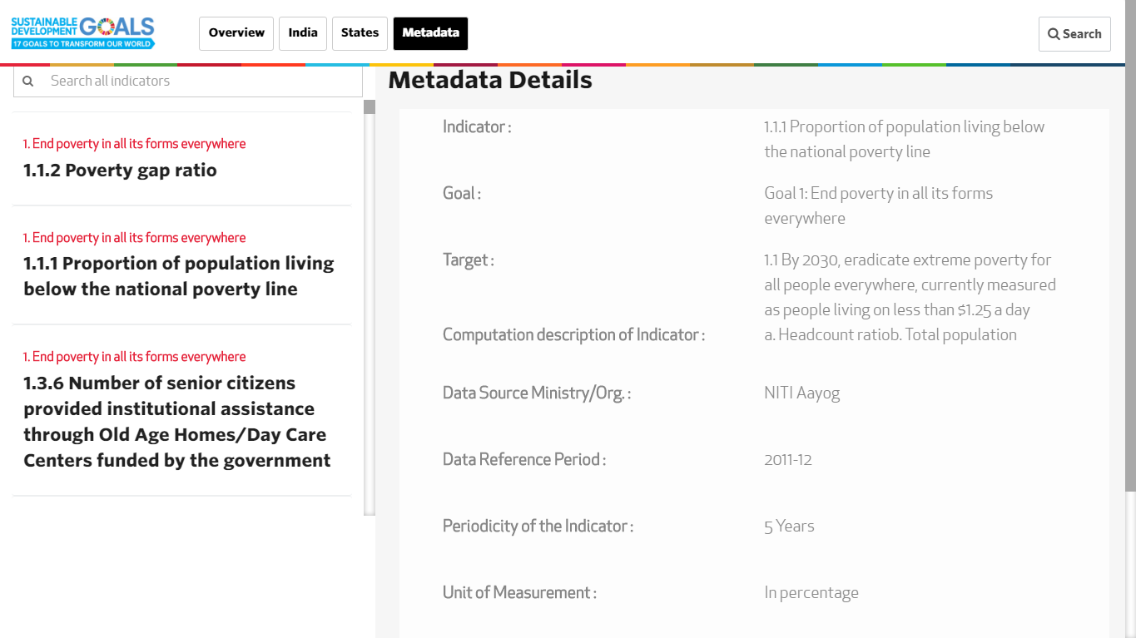
Metadata
Search Indicator for metadata
Select Indicator and view metadata

Slide 14
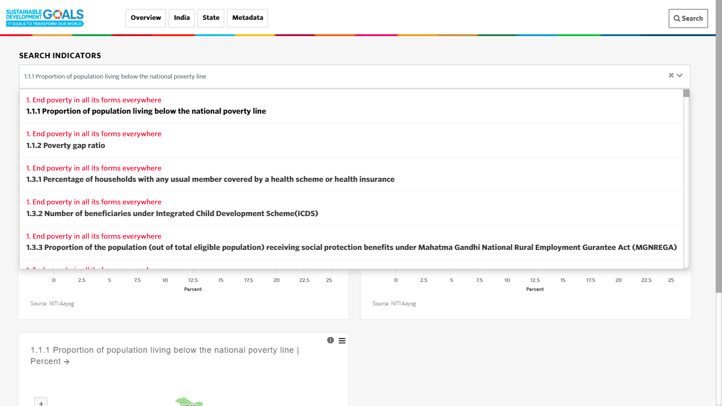
Search
Search Indicator
Select Indicator and view all visualizations of the selected indicator

Slide 15


